Slide 1
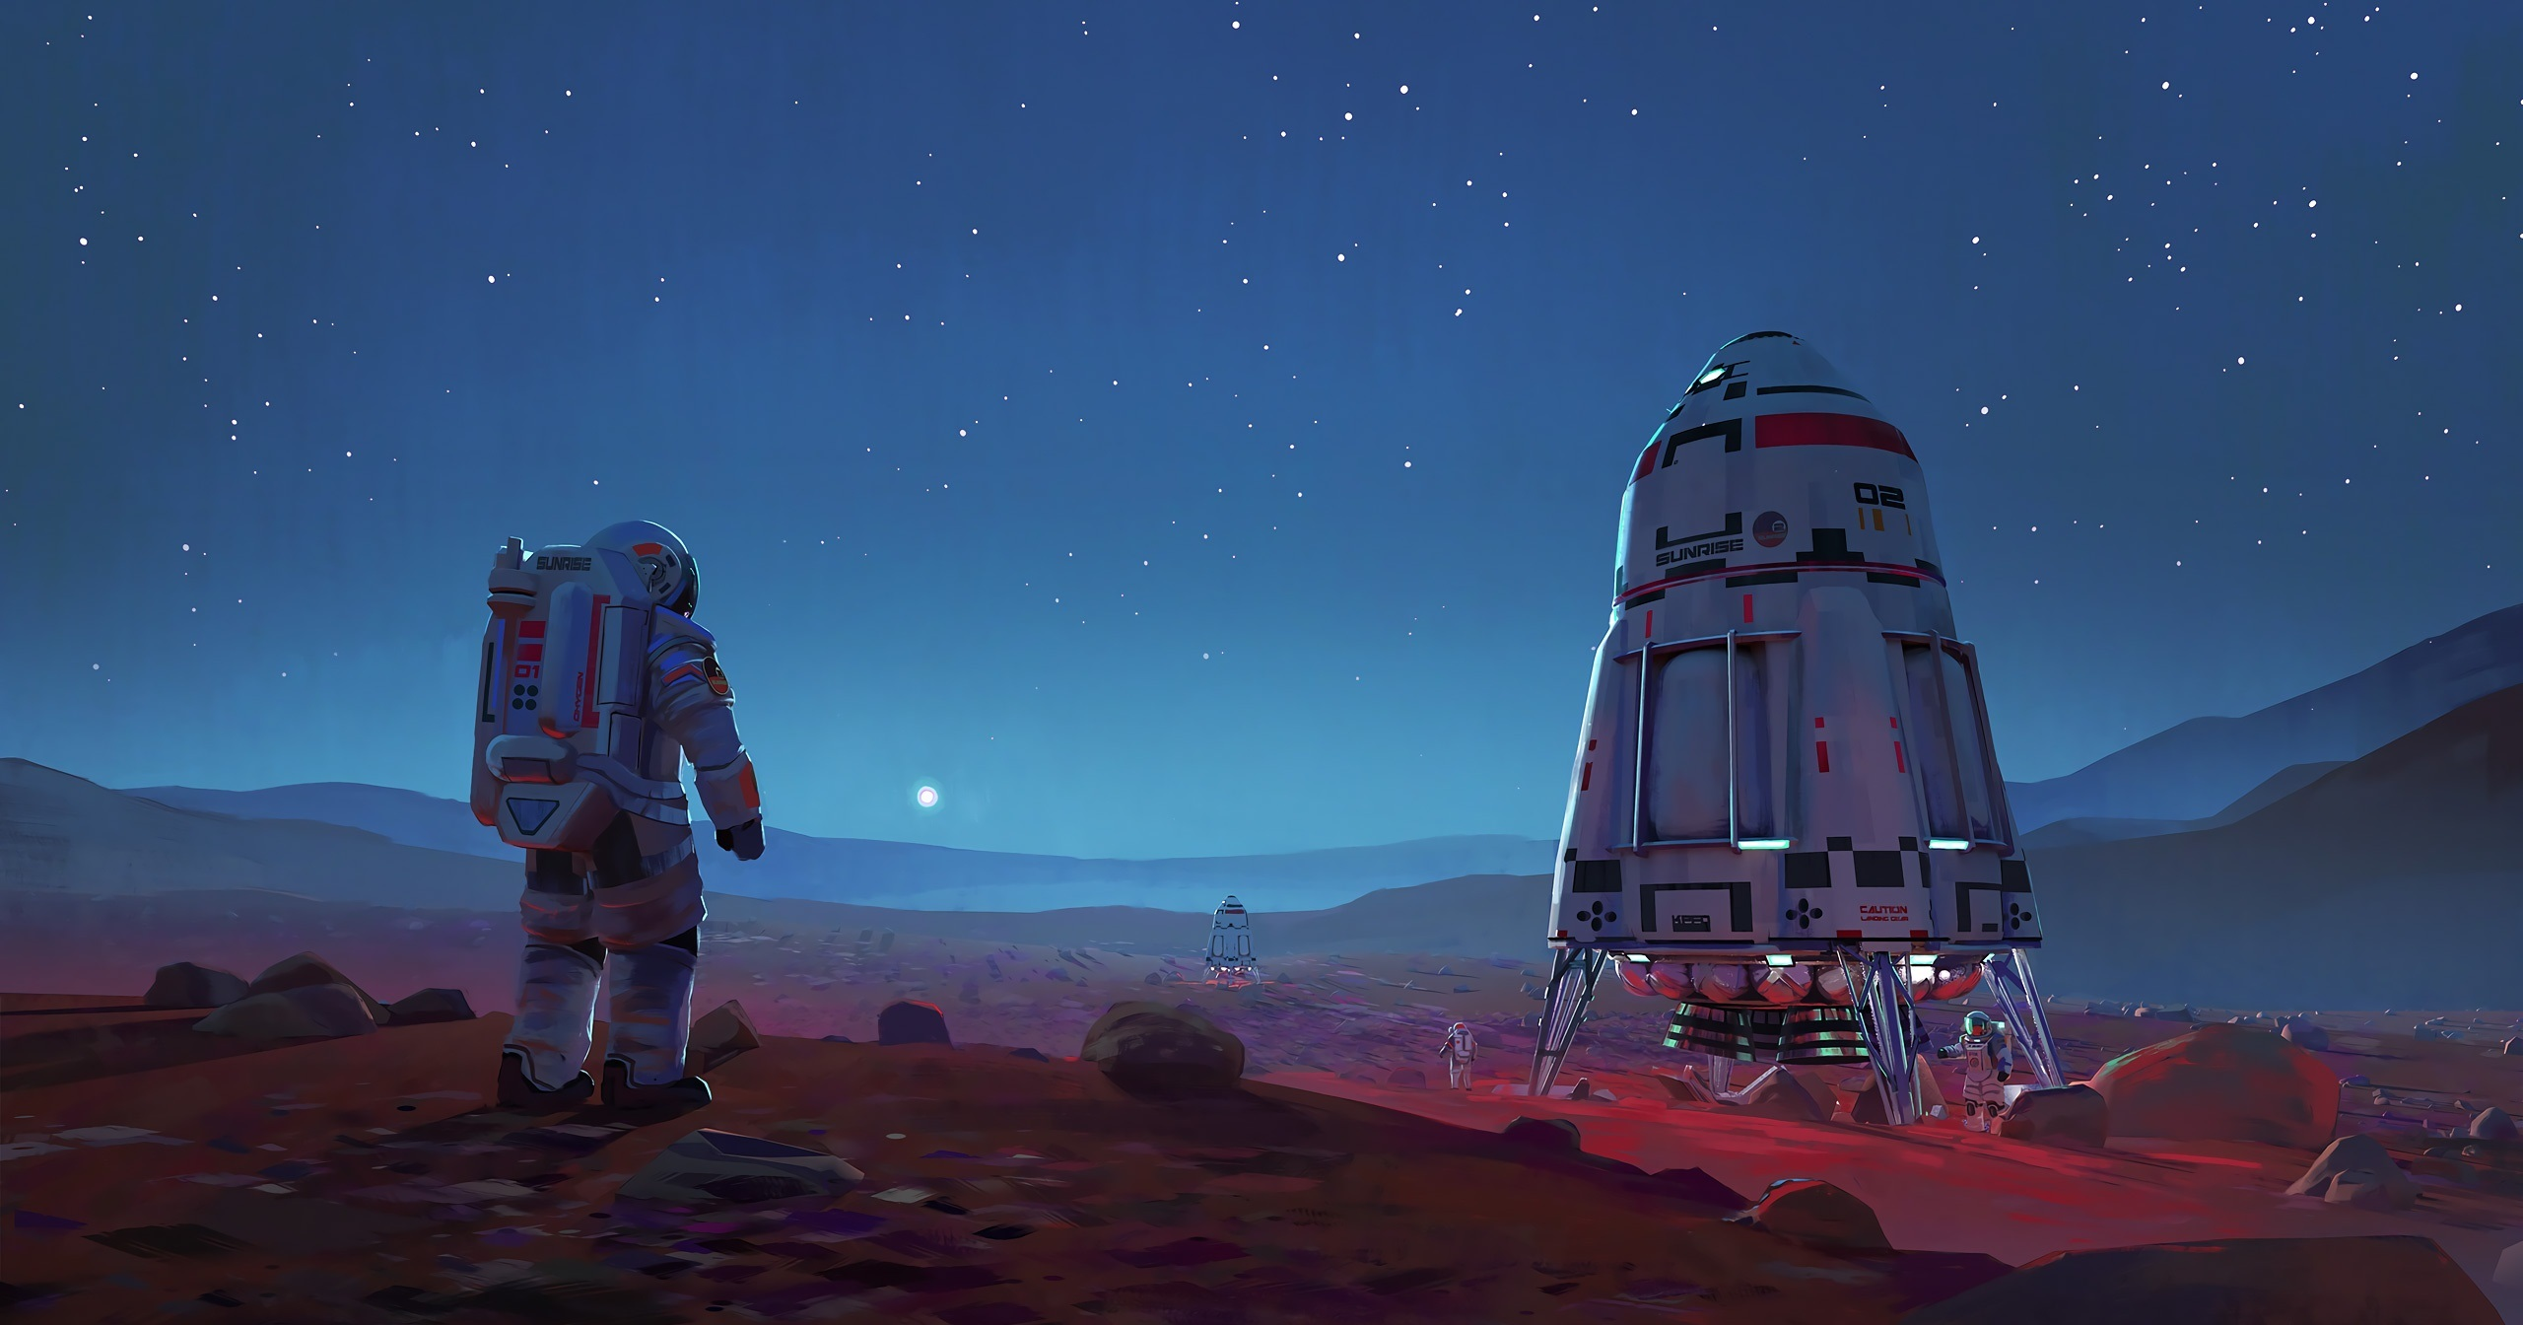
In the Name of God
Chapter 4: New Words
Space Exploration

Slide 2

Accomplish (V):/əˈkɑːm.plɪʃ/
Finish something successfully
The students accomplished the task in less than ten minutes.
The ambassador accomplished such a lot during her visit.
I feel as if I have accomplished nothing since I left my job.

Slide 3
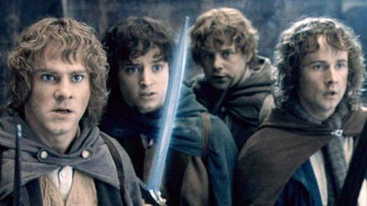
Ally (N): /ˈæl.aɪ/
1. A country that has agreed to give support to another one:
The US is one of Britain's staunchest allies.
During the First World War, Turkey and Germany were allies.
2. Someone who supports someone else:
The manager is considered to be the minister's closest ally.
We are allies!

Slide 4
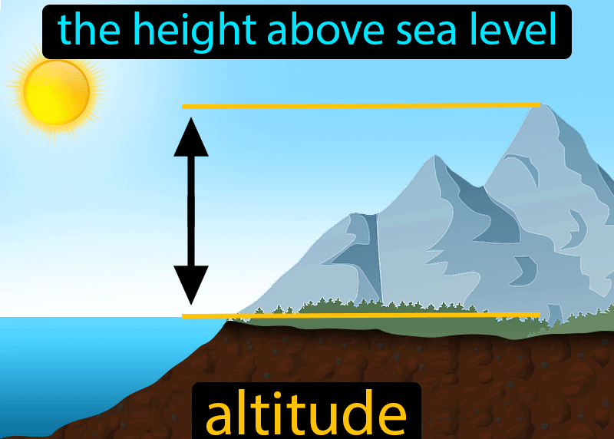
noun [ C ] /ˈæl.tɪ.tʃuːd/
We are currently flying at an altitude of 15,000 meters.
Mountain climbers use oxygen when they reach high altitudes.

Slide 5

Antiquity (N): /ænˈtɪk.wə.t̬i/
The distant past (= a long time ago)
Borage has been used for medicinal purposes since antiquity.
Before creating this sculpture, she studied all the masterpieces of classical antiquity.
Kermit has been interested in growing plants since antiquity!

Slide 6
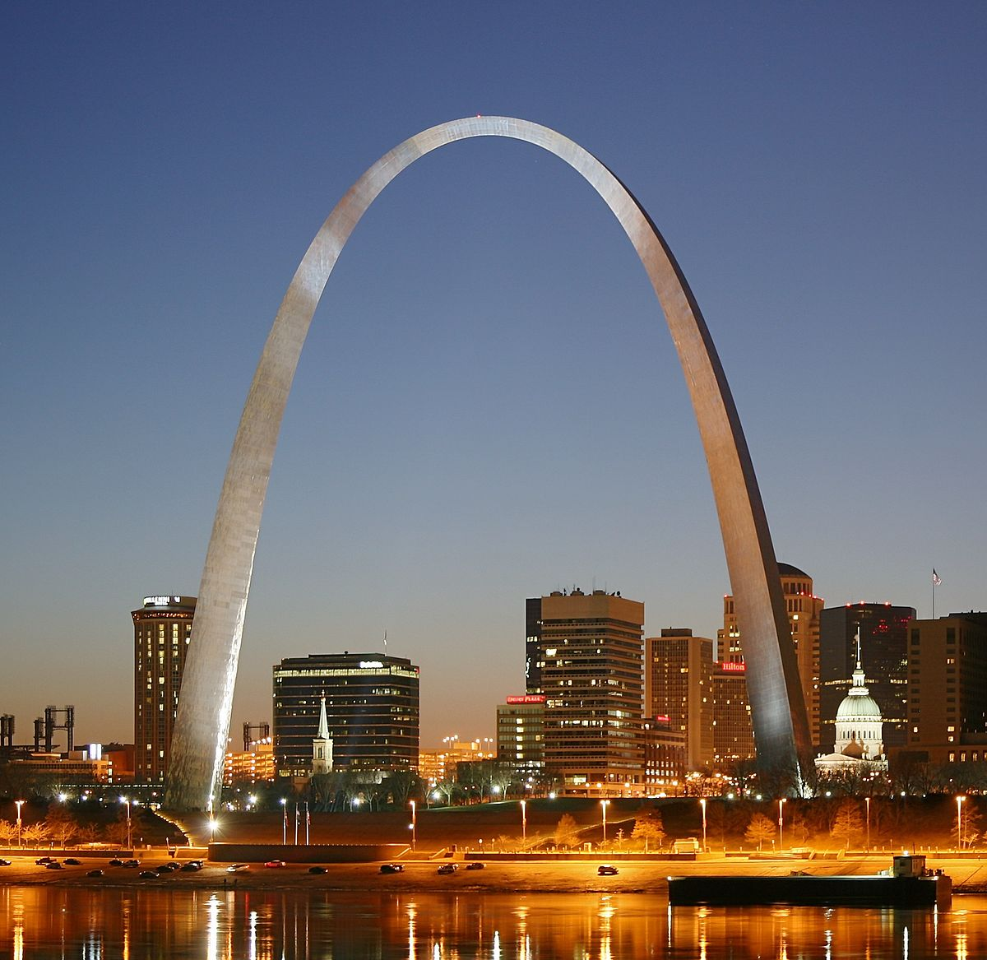
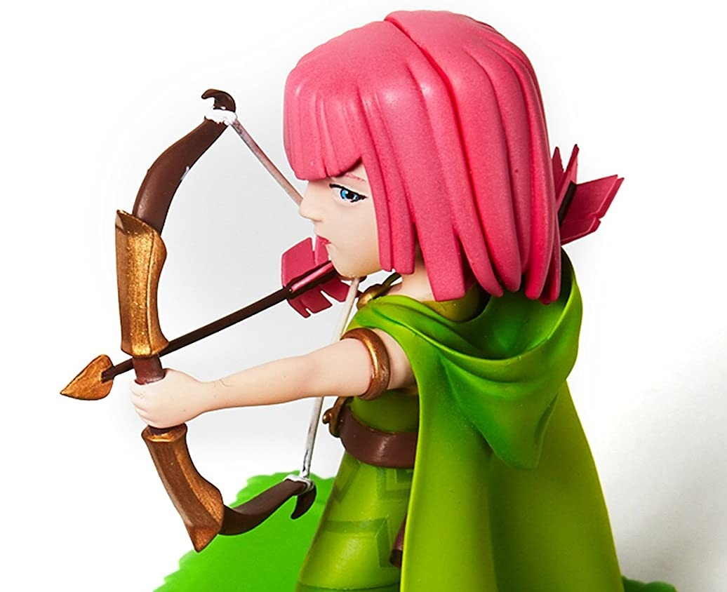
Arch (V): /ɑːrtʃ/
To make the shape of an arch:
Trees arch over the river.
The employer’s eyebrows arched in contempt.

Slide 7
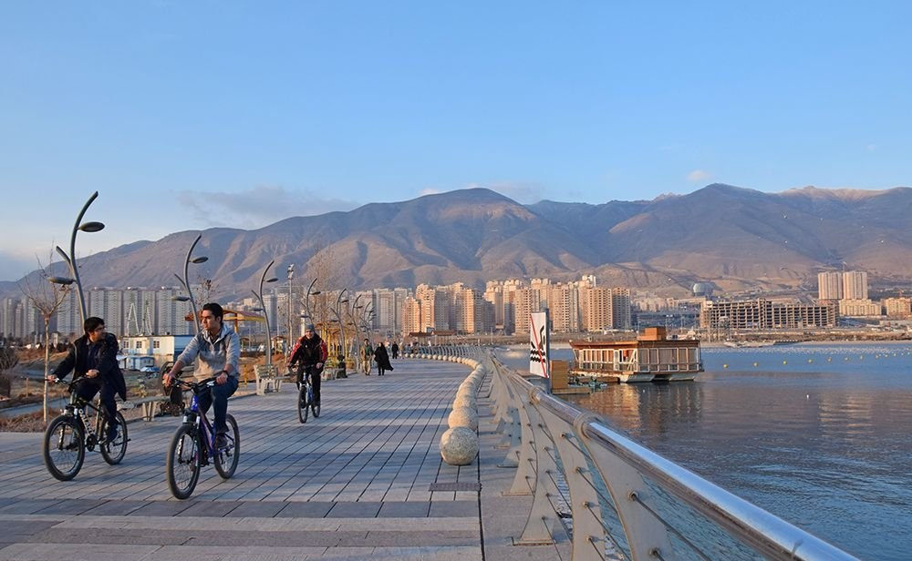
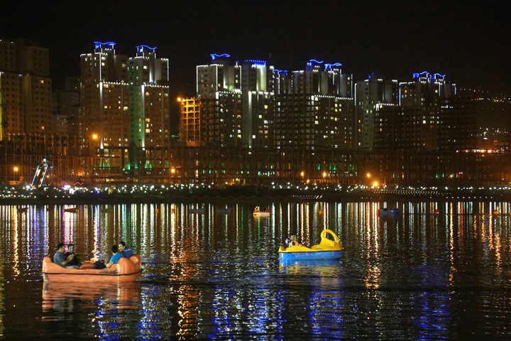
Chitgar lake is an artificial lake!
Artificial (Adj): /ˌɑːr.t̬əˈfɪʃ.əl/
Man-made, not natural:
An artificial heart

Slide 8

Astronaut (N): /ˈæs.trə.nɑːt/
A person who has been trained for travelling in space

Slide 9


Attach (V): /əˈtætʃ/
Join, connect
I attached a photo to my application form.
Use this cable to attach the printer to the computer.

Slide 10
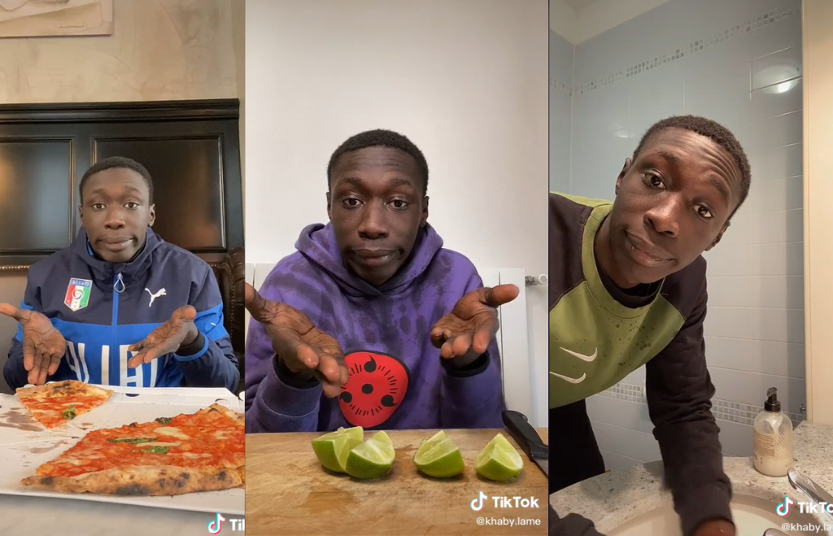

Why not relying on available solutions?
Available (Adj): /əˈveɪ.lə.bəl/
Able to be bought or used:
Is this dress available in a larger size?
It is vital that food is made available to the famine areas.
Do you have any room available this weekend?

Slide 11

Ceremonial (Adj): /ˌser.ɪˈmoʊ.ni.əl/
Related to a ceremony (a formal social event):
The men were dressed in ceremonial black coats.
Who won the ceremonial award of the best FIFA football player?

Slide 12
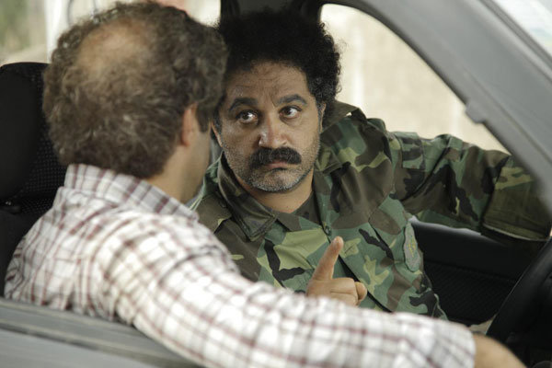
Civilian (N): /səˈvɪl.jən/
Not a member of the police or the armed forces:
The bomb killed four soldiers and three civilians.
Naghi is a civilian!

Slide 13
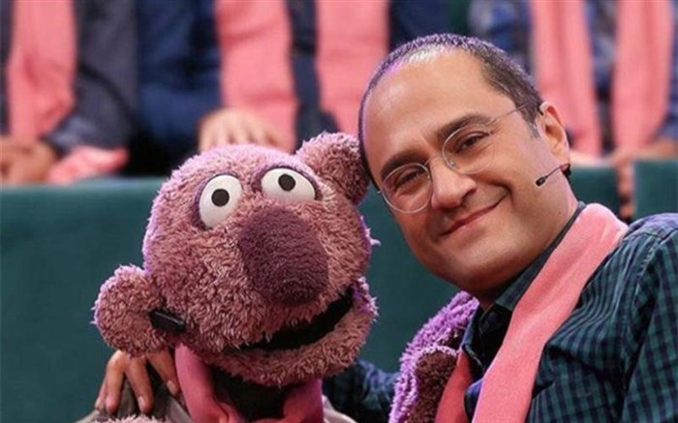
Coalition (N): /koʊ.əˈlɪʃ.ən/
The joining together of different parties/groups for a specific purpose.
The coalition immediately decided to cut the spending.
“Rambod-Janab Khan” coalition for saving PSG

Slide 14
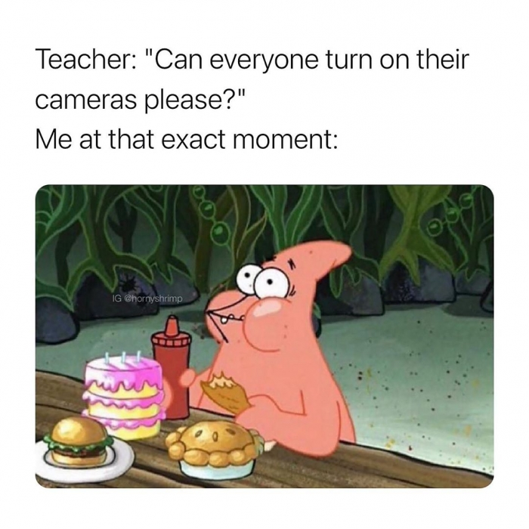
Communication breakdown!
Communication (N): /kəˌmjuː.nəˈkeɪ.ʃən/
The act of communicating:
Television is an increasingly important means of communication.
With no decent phone signal , communication is difficult.

Slide 15

Compatible (Adj): /kəmˈpæt̬.ə.bəl/
Able to exist, live, or work successfully with something or someone else:
Make sure that the software is compatible with the other applications you want to run.
Certain drugs are not compatible and should never been taken together.
We are not compatible!

Slide 16
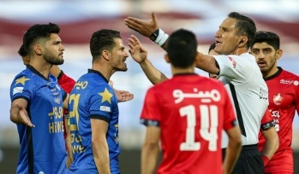
Conflict (N): /ˈkɑːn.flɪkt/
Disagreement between people
There was a lot of conflict between the teenager and his father.
The conflict between tradition and innovation
Conflict between the two players

Slide 17
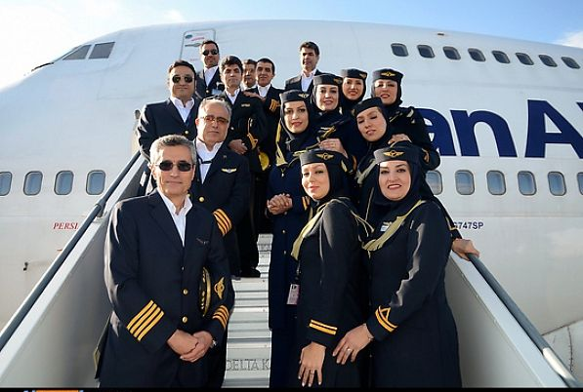
Crew (N): /kruː/
A group of people working together
An ambulance/lifeboat crew
A TV/film crew
The aircraft has a crew of seven.
IranAir Crew

Slide 18


Decade (N):/ˈdek.eɪd/
A period of ten years
Air traffic has increased 30% in the last decade.
A large earthquake will strike the east coast before the end of the decade.
Environmental awareness has increased dramatically over the past decade.

Slide 19
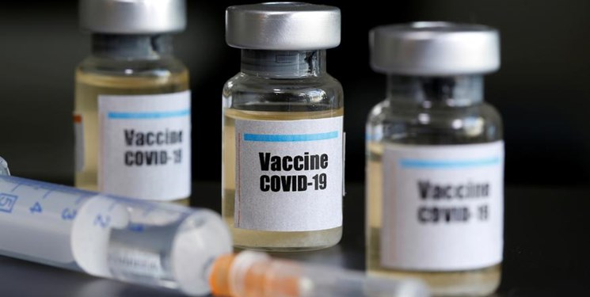
Decisive (Adj): /dɪˈsaɪ.sɪv/
Unmistakable, unquestionable
A decisive role/victory
The economy is regarded as the decisive factor which will determine the outcome of the election.
Unless decisive action is taken to combat COVID-19, the death toll will continue to rise.

Slide 20
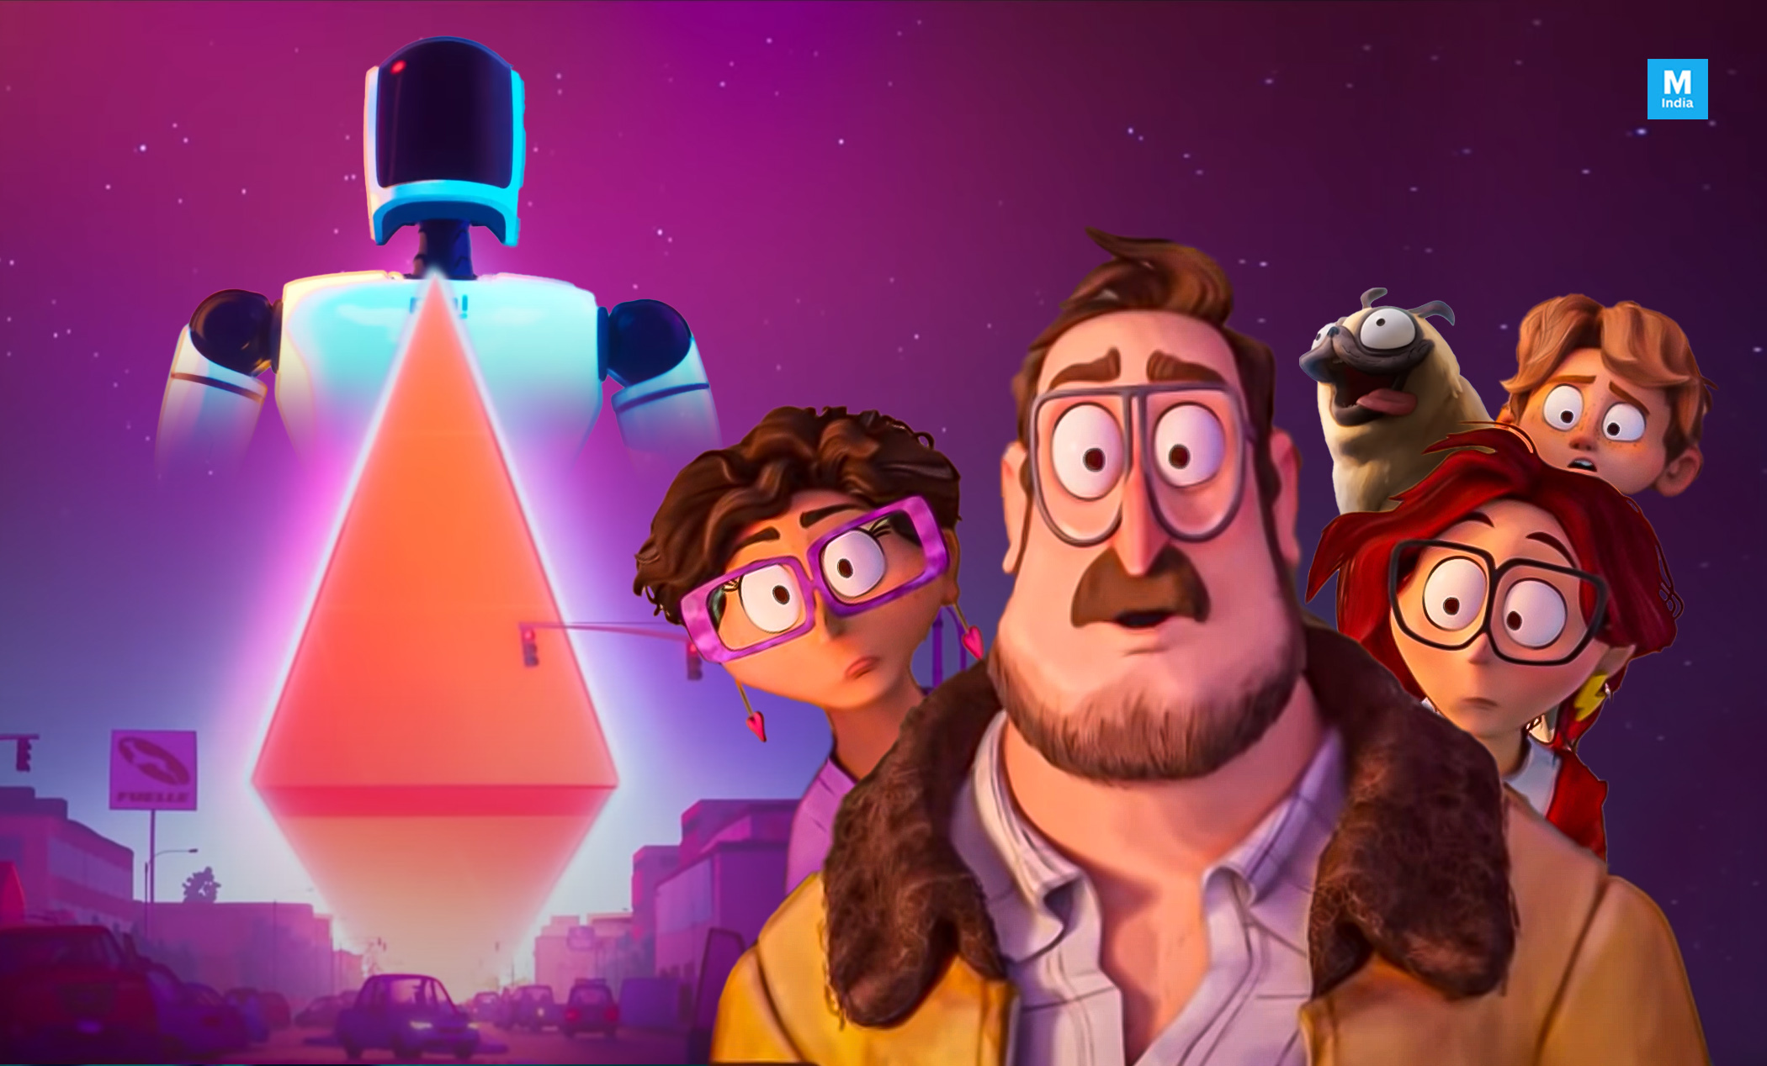
Defence against robots
Defence (N): /dɪˈfens/
Protection, support
The rebels’ only form of defence against the soldiers’ guns was sticks

Slide 21
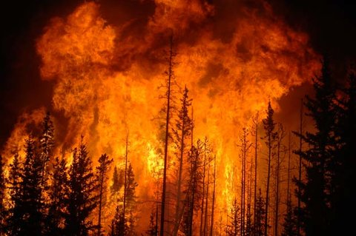
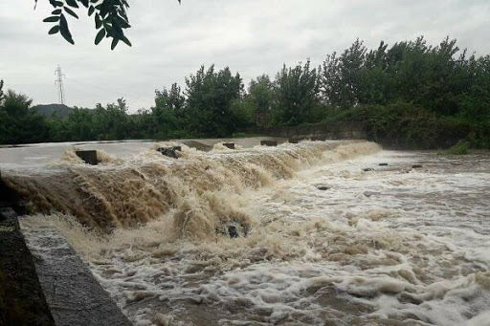
Disaster (N): /dɪˈzæs.tɚ/
An event that results in great harm, damage, or death, or serious difficulty:
An inquiry was ordered into the recent rail disaster (= a serious train accident).
It would be a disaster for me if I lost my job.

Slide 22
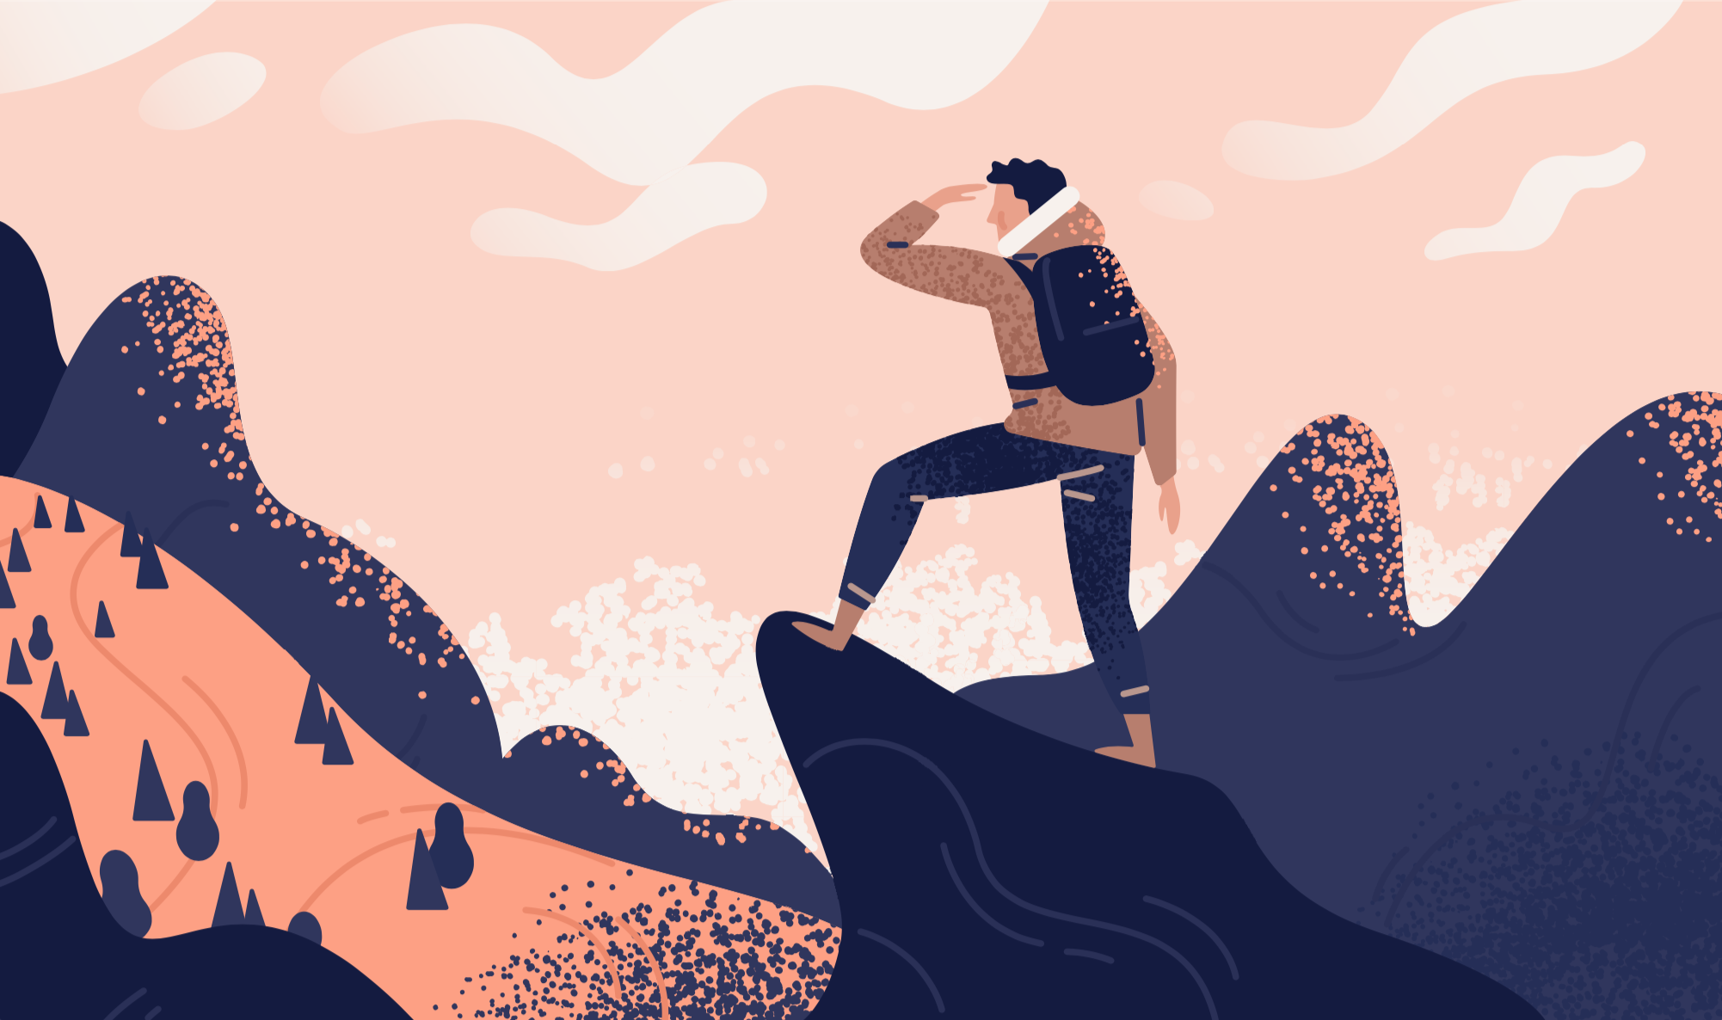
Exploration (N): /ˌek.spləˈreɪ.ʃən/
The activity of searching and finding out about something:
We need to carry out a full exploration of all the alternatives.
The exploration for new sources of energy is vital for the future of our planet.

Slide 23

Featureless (Adj): /ˈfiː.tʃɚ.ləs/
Looking the same in every part:
A featureless desert
A grey featureless landscape

Slide 24

Fulfil (V): /fʊlˈfɪl/
Make happen
A school fails if it does not fulfil the needs/requirements of its pupils.
At the age of 45, she finally fulfilled her ambition to run a marathon.
We're looking for a very specific sort of person and this woman seems to fulfil all of our criteria.
So did the course fulfil all your expectations?
NASA is fulfilling a long-held dream!

Slide 25

Gravity (N): /ˈɡræv.ə.t̬i/
The force that attracts objects towards one another, especially the force that makes things fall to the ground:
The laws of gravity

Slide 26

Facility (N): /fəˈsɪl.ə.t̬i/
Equipment
A research facility
Medical facilities

Slide 27
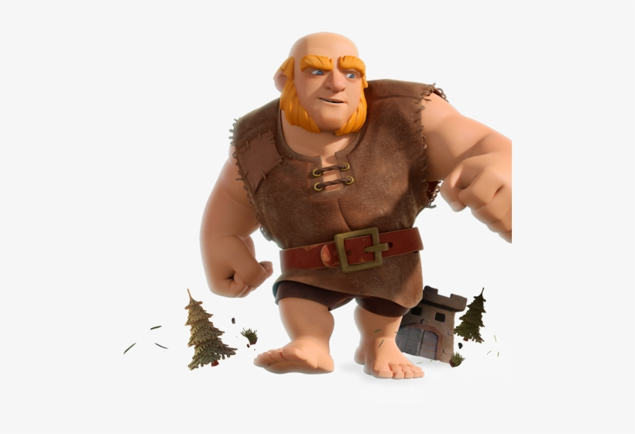
Giant (Adj): /ˈdʒaɪ.ənt/
Extremely large
A giant earth-moving machine
To take giant steps

Slide 28
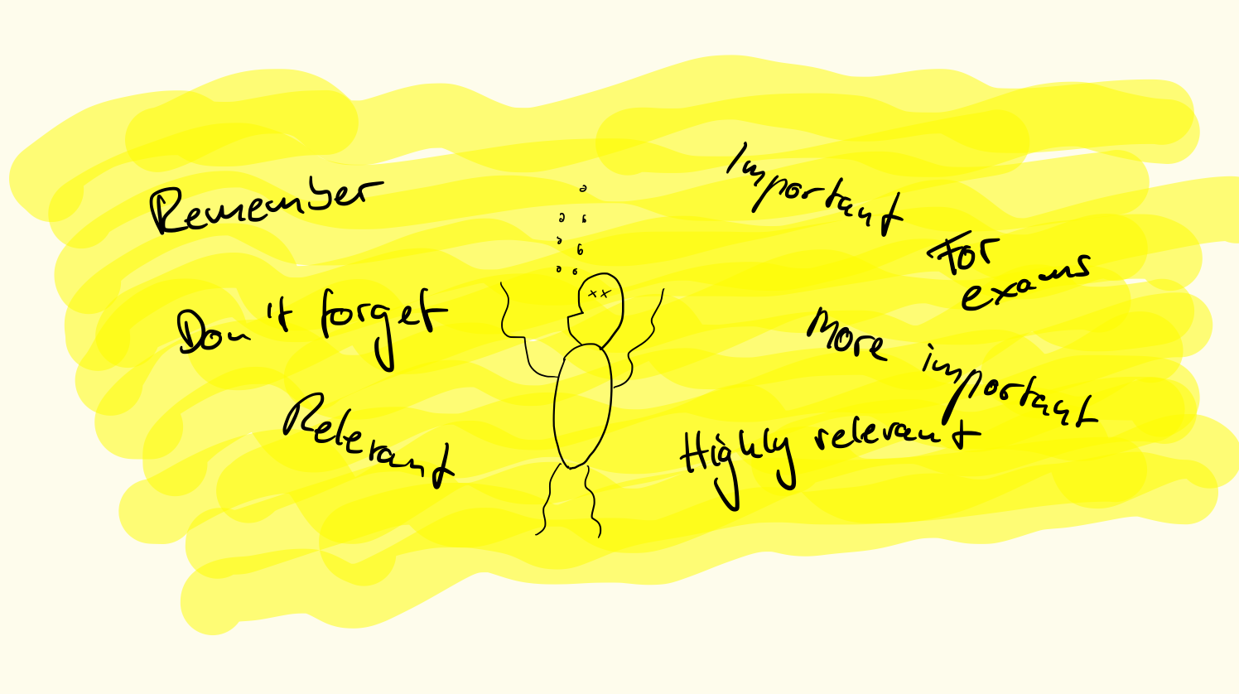
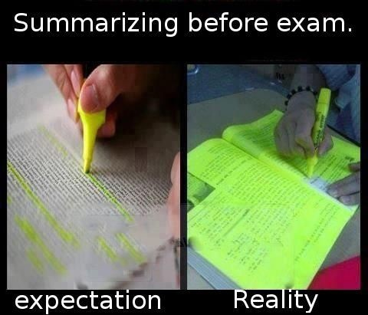
Highlight (V): /ˈhaɪ.laɪt/
To attract attention to or emphasize something important:
The report highlights the need for improved safety.
The spelling mistakes in the text had been highlighted in green.

Slide 29
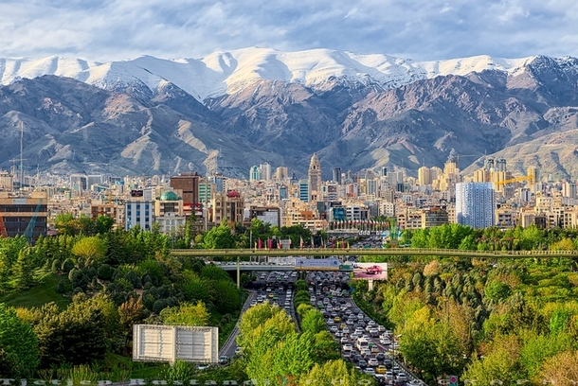
Homeland (N): /ˈhoʊmˌlænd/
The country where you were born
Iran is our homeland.

Slide 30
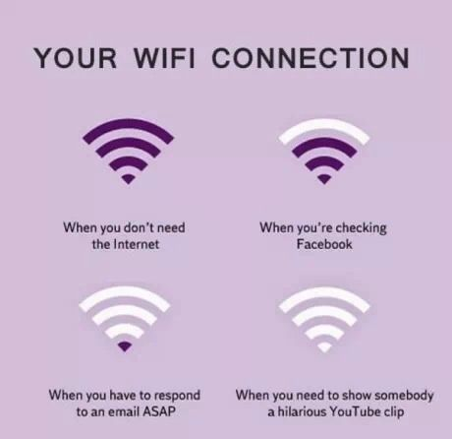
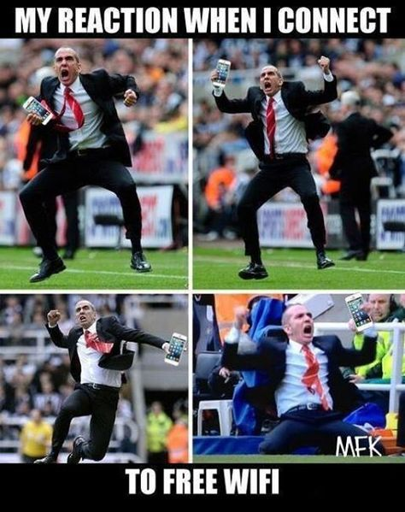
Integral (Adj): /ˈɪn.t̬ə.ɡrəl/
Necessary, important
The manger is an integral part of the team and we can't do without him.
WI-FI is integral to our daily lives!

Slide 31
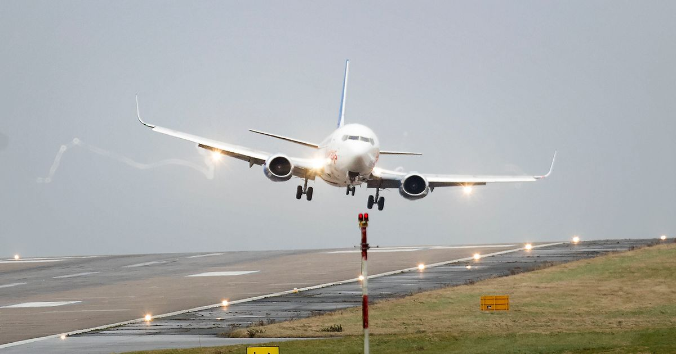
Land (V): /lænd/
Arrive
We should land in Madrid at 7 a.m.
You can land a plane on water in an emergency.
The bird landed on my finger.

Slide 32

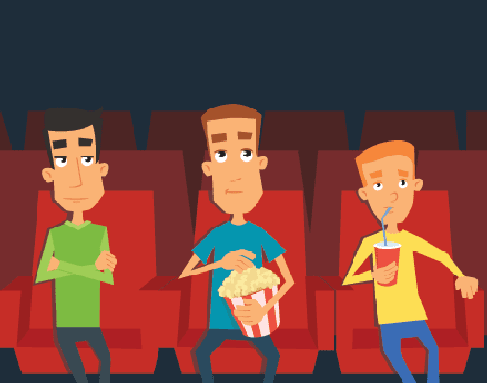
Latter (Adj): /ˈlæt̬.ɚ/
near or towards the end of something:
Building of the new library should begin in the latter part of next year.
In the latter stages of the fight, he began to retreat.
I love the latter part of the movie!

Slide 33

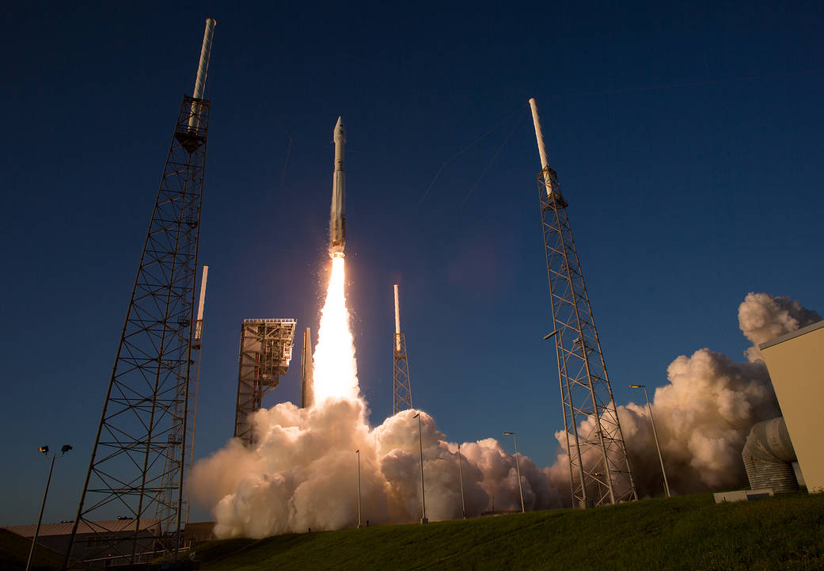
Launch (V): /lɑːntʃ/
1. Begin
The program was launched a year ago.
The airline will launch its new transatlantic service next month.
2. To send something out, such as a new ship into the water or a spacecraft into space:
A spokesman said they hoped to launch the first submarine within two years.
To launch a missile

Slide 34

Lead (V)/liːd/
Control
I think we've chosen the right person to lead the expedition.
I've asked my friend to lead the discussion.
Mr. Leader

Slide 35
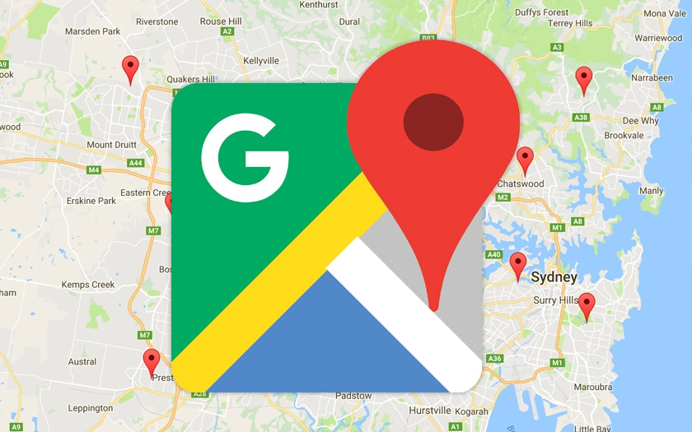
Map (V):/mæp/
To represent an area of land in the form of a map:
Parts of the mountainous region in the north of the country have still not been mapped.

Slide 36
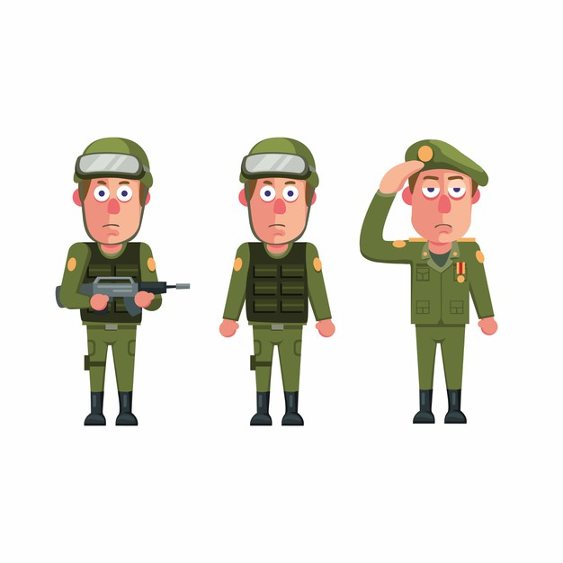
Military (Adj):/ˈmɪl.ə.ter.i/
Relating to or belonging to the armed forces:
Foreign military intervention
Military targets/forces
Military uniform

Slide 37
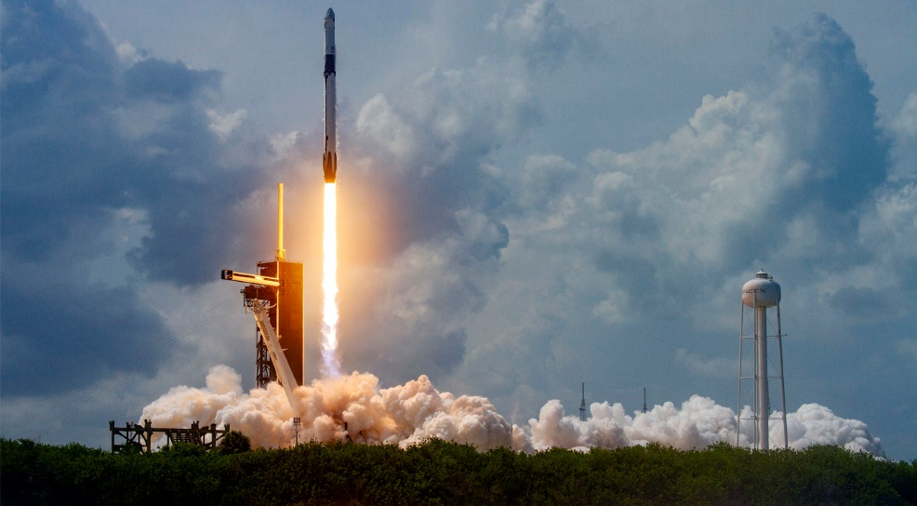
Missile (N): /ˈmɪs.əl/
A flying weapon that has its own engine so that it can travel a long distance before exploding at the place that it has been aimed at:
a missile launcher

Slide 38

Mission (N): /ˈmɪʃ.ən/
An important job
Your mission is to isolate the enemy by destroying all the bridges across the river.
a peace/rescue/fact-finding mission

Slide 39

Navigation (N): /ˌnæv.əˈɡeɪ.ʃən/
The act of directing from one place to another
In the past, navigation depended on a knowledge of the positions of the stars.
Mechanics discovered problems with the plane's navigation system.

Slide 40
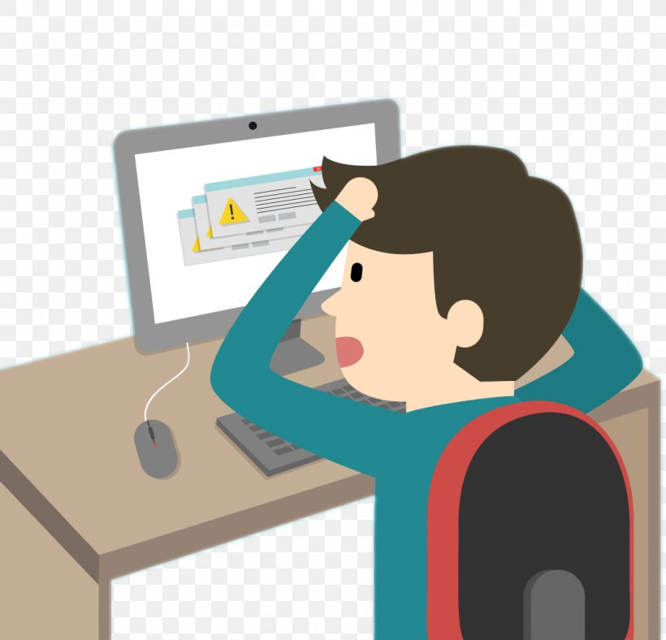
Occur (V) /əˈkɝː/
Happen, take place
An accident involving over ten vehicles has occurred in the east-bound lane.
If any of these symptoms occur while you are taking the medication, consult your doctor immediately.
Many suicides occur in prisons.
We are of course investigating how an error like this could have occurred.
Error occurred!

Slide 41

Orbit (V): /ˈɔːr.bɪt/
to follow a curved path around a planet or star:
On this mission, the Shuttle will orbit (the Earth) at a height of several hundred miles.

Slide 42
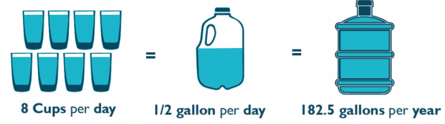
Per (Preposition): /pər/
Each
The meal will cost $20 per person.
The car was travelling at 70 miles per hour (70 mph).
There are more cafés per square mile here than anywhere else in the country.

Slide 43
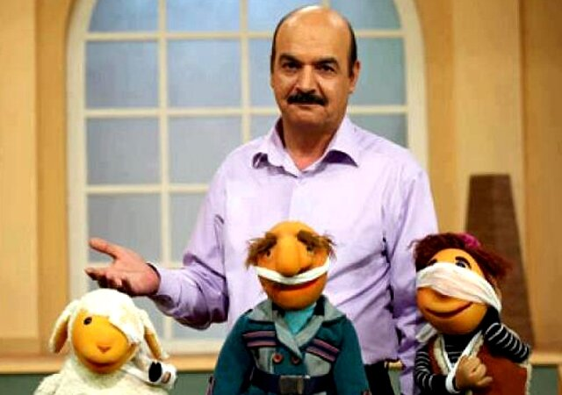
Pinpoint (V): /ˈpɪn.pɔɪnt/
Find out, discover
It is not possible to pinpoint precisely the time of death.
Emergency workers at the site are still unable to pinpoint the cause of the explosion.
Let’s pinpoint the cause of the problem!

Slide 44
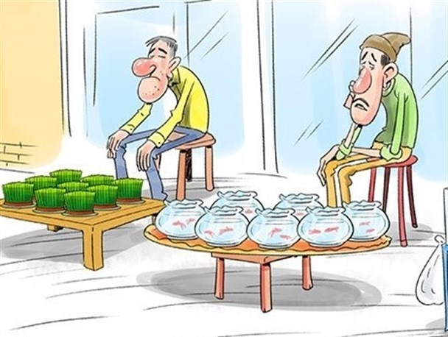
Possibility (N): /ˌpɑː.səˈbɪl.ə.t̬i/
Likely to happen
The forecast said that there's a possibility of snow tonight.
There's a distinct possibility (that) I'll be asked to give a speech.
Is there any possibility (that) you could pick me up from the station?
What is the possibility of making money?

Slide 45
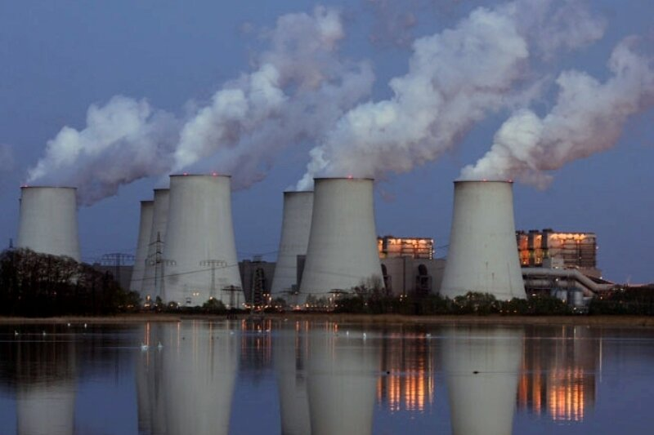
Power plant (N): /ˈpaʊ.ɚ ˌplænt/
A power station

Slide 46
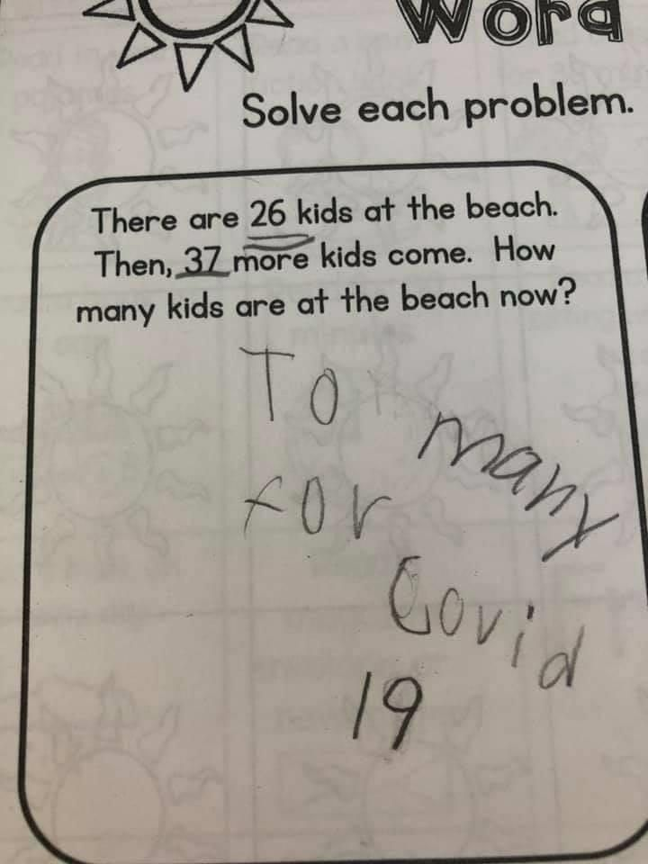
Precise (Adj): /prəˈsaɪs/
Exact and accurate
The bunker's precise location is a closely guarded secret.
He caught me at the precise moment that I fainted.
There was a good turnout for the meeting - twelve of us to be precise.
How precise!

Slide 47
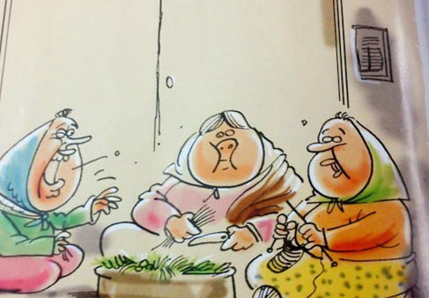
Probe (V): /proʊb/
Examine, try to discover
The women are probing deep into the neighbors’ private lives.
Detectives questioned him for hours, probing for any inconsistencies in his story.
They probed in/into the mud with a special drill.

Slide 48
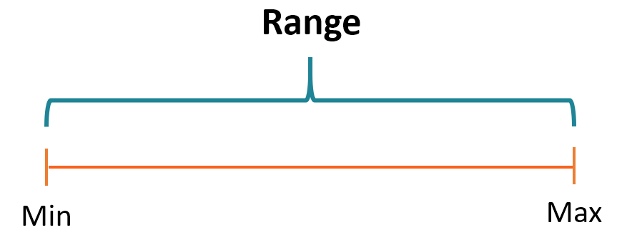
Range (N): /reɪndʒ/
a set of similar things:
I offered her a range of options.
There is a wide/whole range of opinions on this issue.

Slide 49
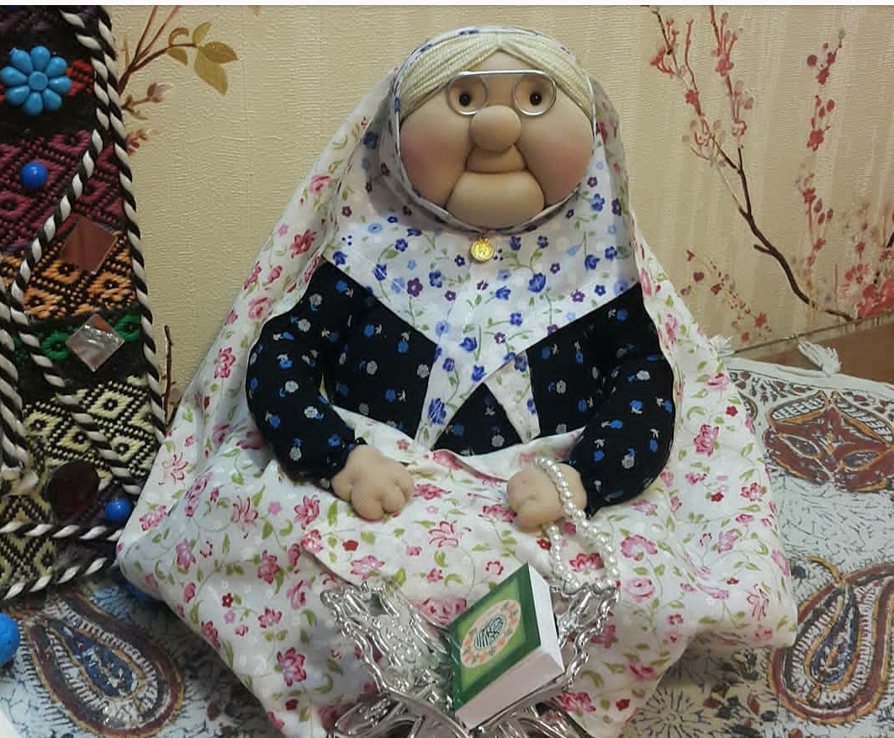
Reliance (N): /rɪˈlaɪ.əns/
The state of depending on or trusting in something or someone:
The region's reliance on tourism is unwise.
You place too much reliance on her ideas and expertise.
My reliance on my grandmother’s prayers is definite.

Slide 50
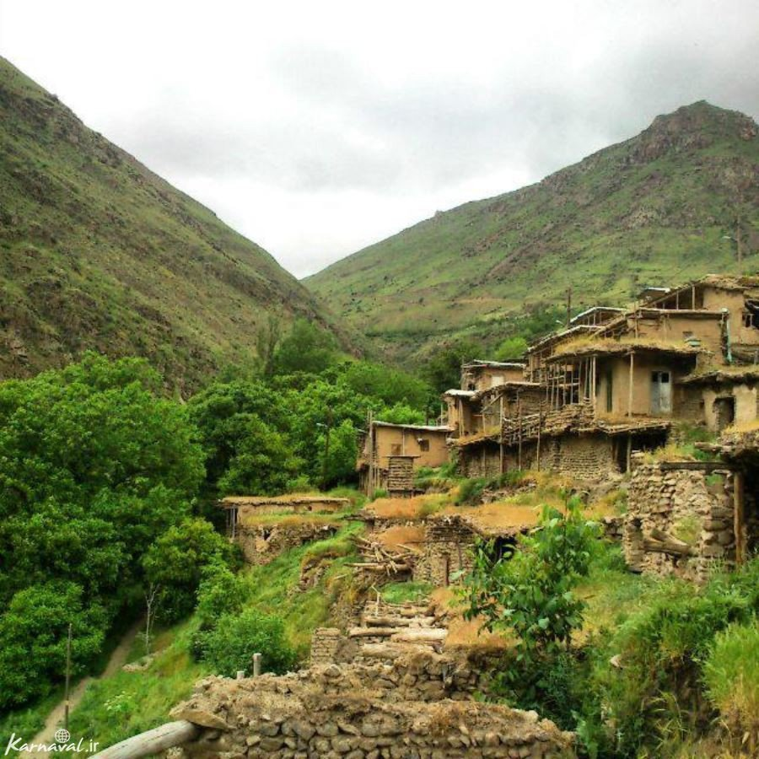
Remote (Adj): /rɪˈmoʊt/
Distant, far
Remote galaxies
They live in a remote corner of the country, miles from the nearest shop.

Slide 51
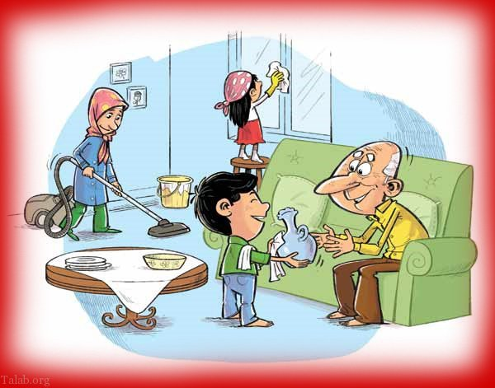
Requirement (N): /rɪˈkwaɪr.mənt/
something that you must do, or something you need:
A good degree is a minimum requirement for many jobs.
It is a legal requirement that you have insurance for your car.
Students who fail to meet the requirements (of the course) will fail.
Cooperation is a requirement for housecleaning!

Slide 52
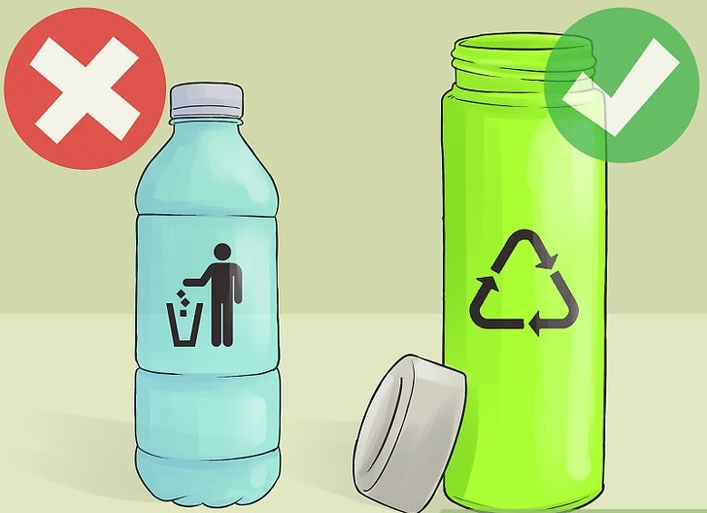
Reusable (Adj): /ˌriːˈjuː.zə.bəl/
Able to be used more than once:
Reusable packaging
I always carry a reusable shopping bag.
Reusable bottles

Slide 53

Ring (N): /rɪŋ/
A circle of any material, or any group of things or people in a circular shape or arrangement:
The game involved throwing metal rings over a stick.
The students sat in a ring around the teacher.

Slide 54
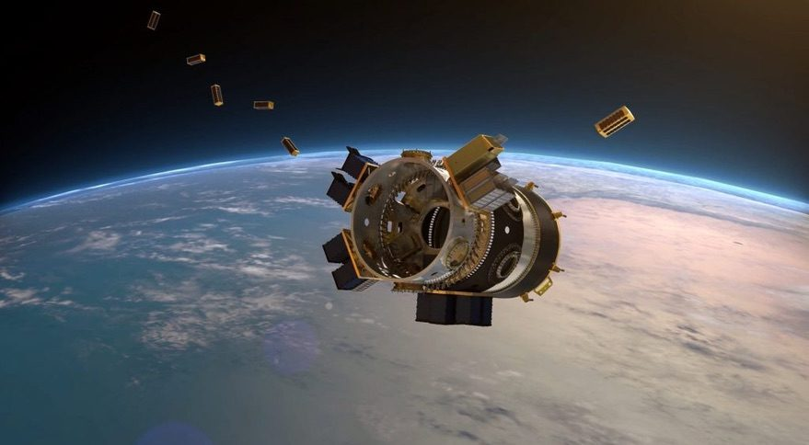
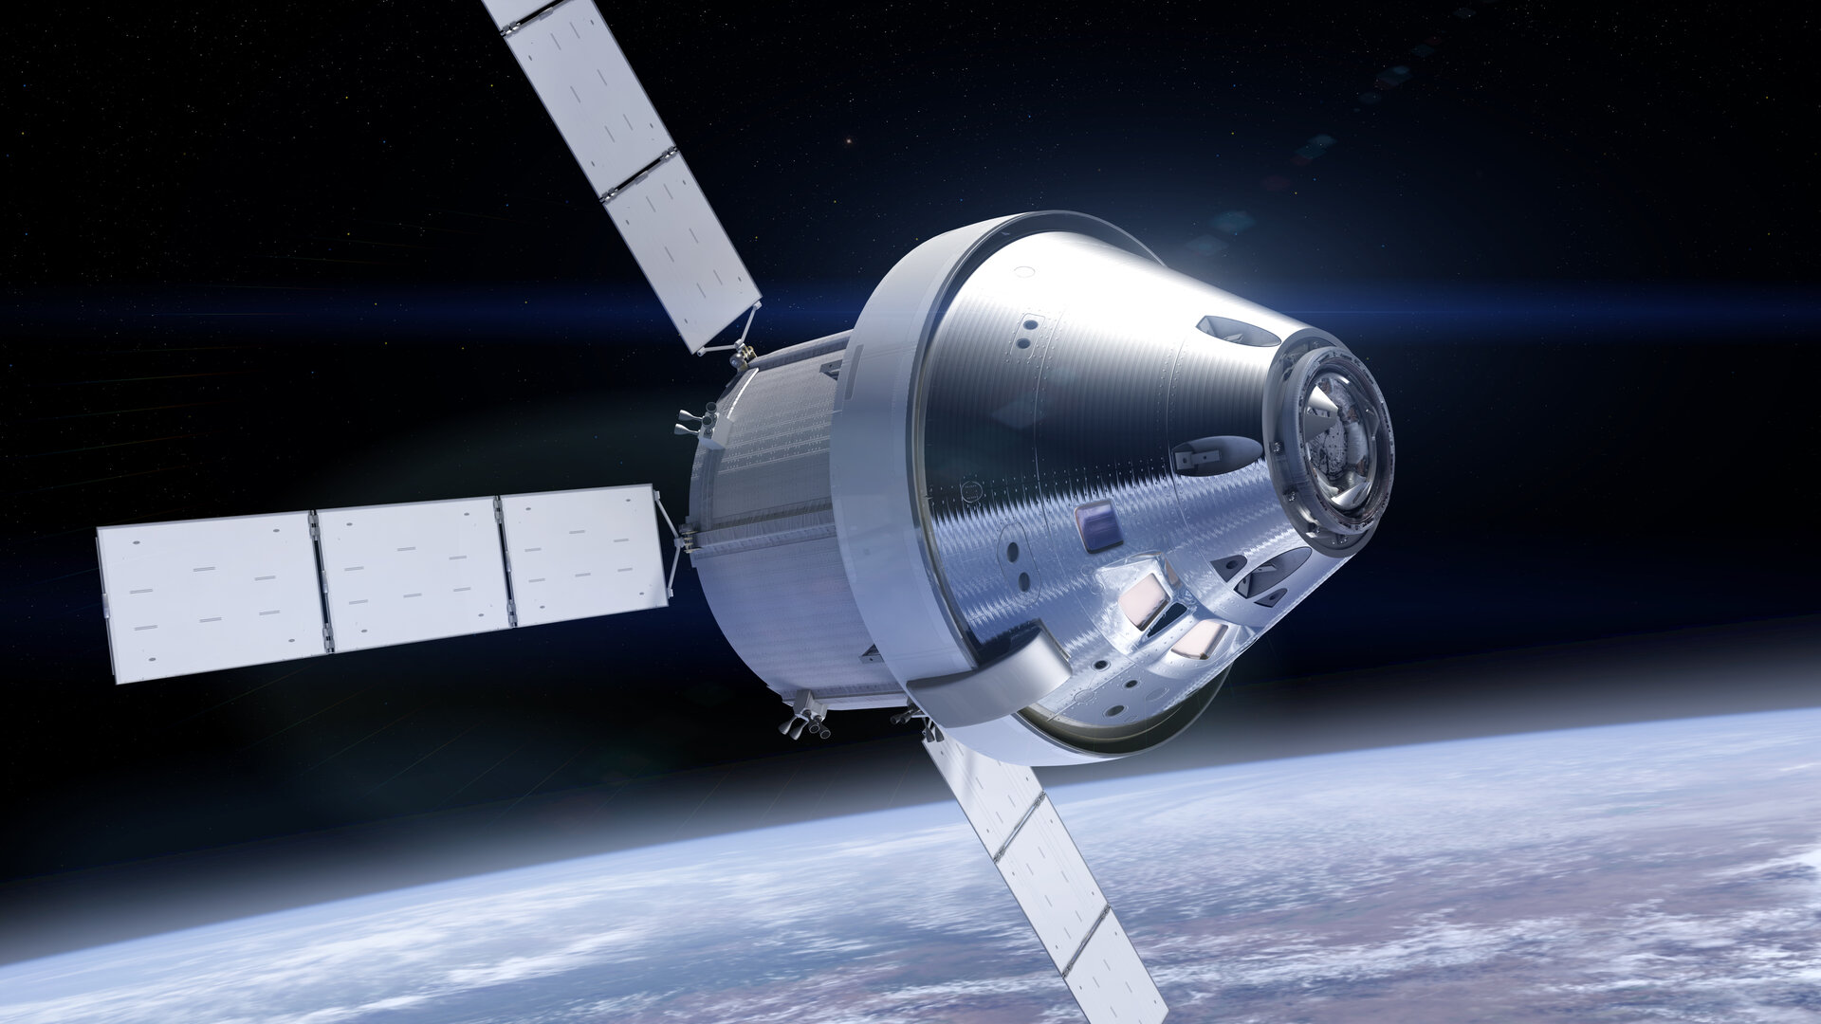
Spaceflight
Spacecraft

Slide 55
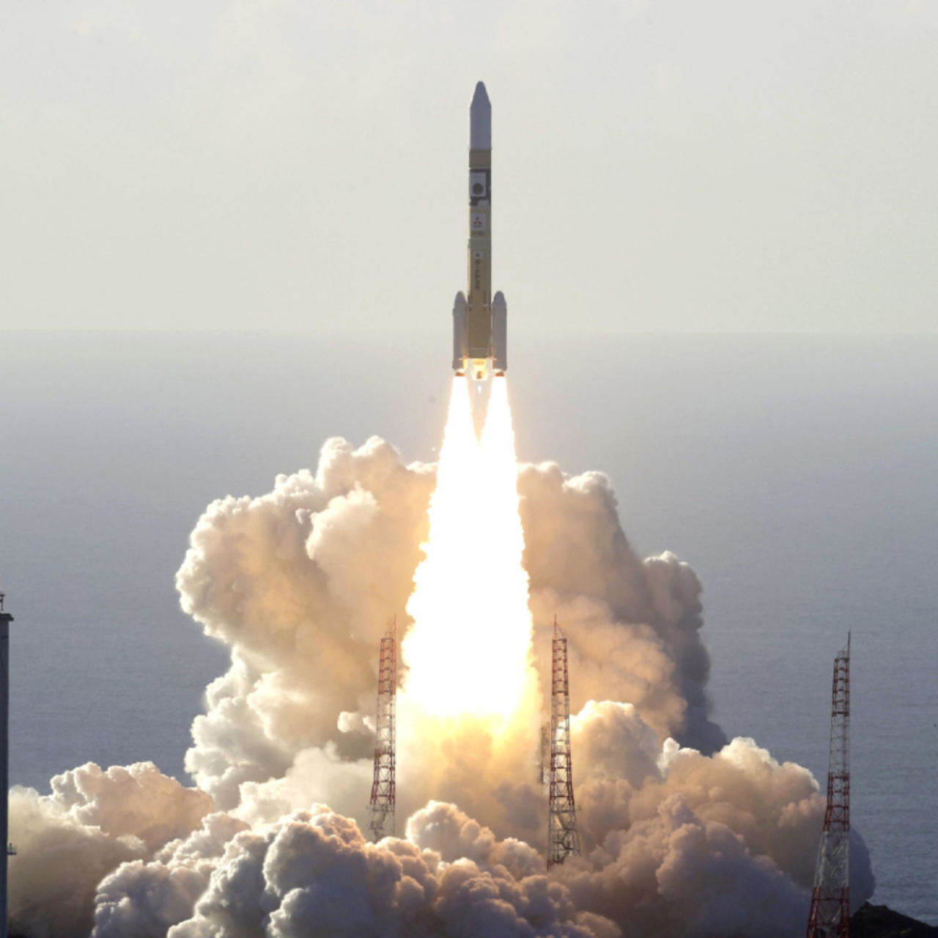
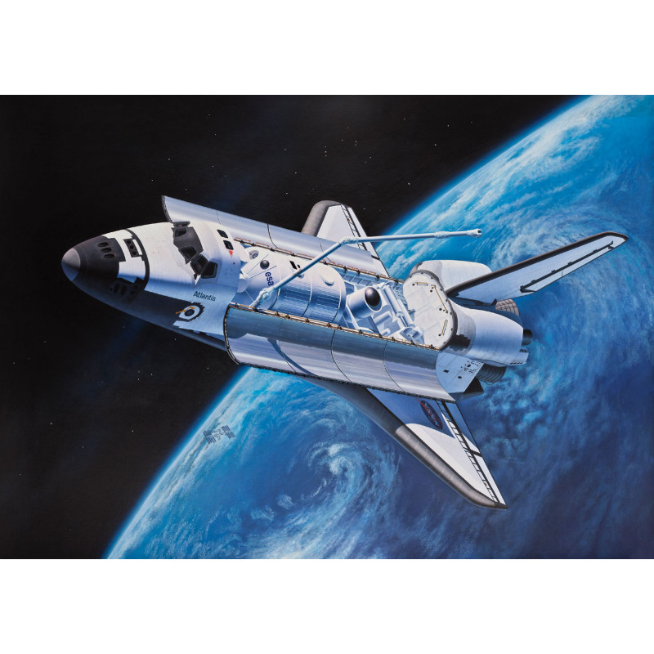
Rocket
Shuttle

Slide 56
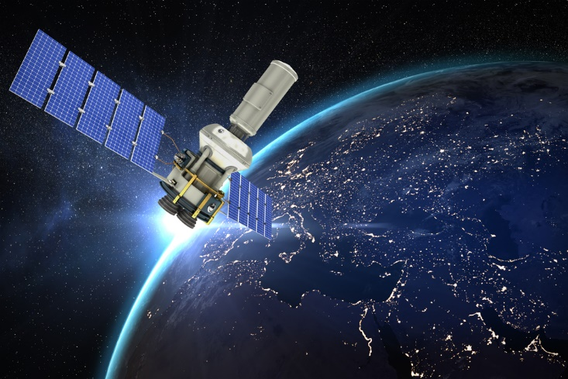
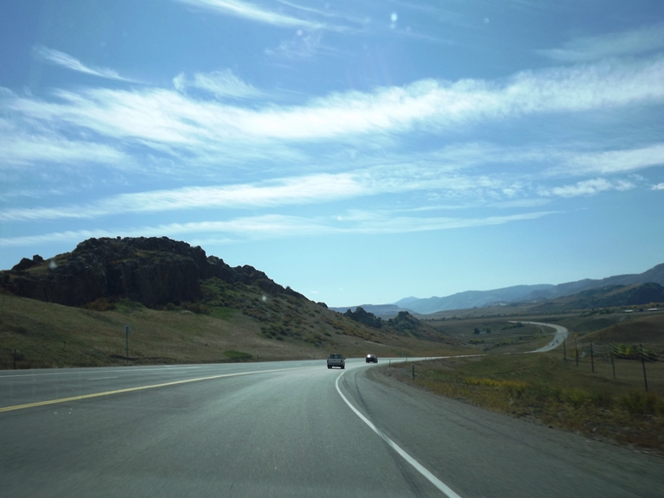
Satellite
Long-distance

Slide 57


Schedule (N): /ˈskedʒ.uːl/
Timetable, plan
a hectic/tight (= very busy) schedule
Everything went according to schedule (= as had been planned).

Slide 58

Simultaneously (Adv): /ˌsaɪ.məlˈteɪ.ni.əs.li/
Happening or being done at exactly the same time
Two students answered the teacher's question simultaneously.
The network was broadcasting four games simultaneously across the country.
She was cooking a meal while simultaneously holding a business meeting via her mobile phone.

Slide 59
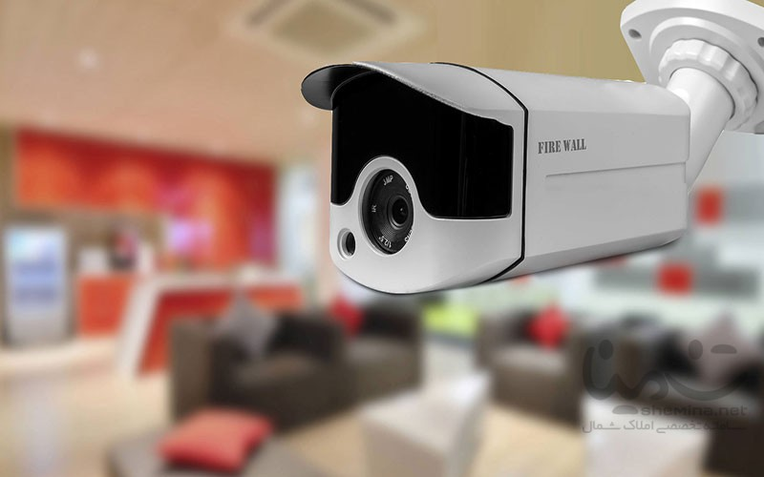

Surveillance (N): /sɚˈveɪ.ləns/
The careful watching of a person or place, especially by the police or army, because of a crime that has happened or is expected:
The police have kept the station under surveillance because of suspected illegal drug activity.
More banks are now installing surveillance cameras.

Slide 60
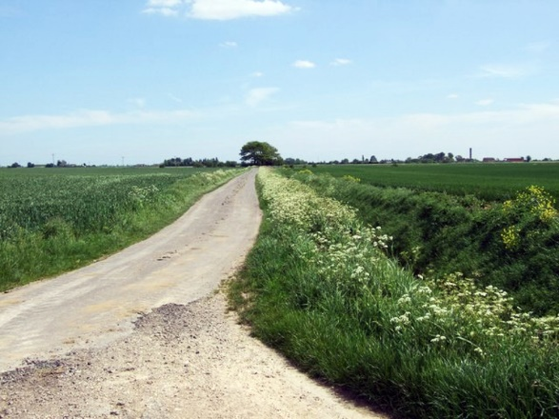
Terrain (N): /təˈreɪn/
an area of land, when considering its natural features:
The car handles particularly well on rough terrain.

Slide 61

Troop (N): /truːp/
Soldiers on duty in a large group:
Traditionally, United Nations troops have been deployed only in a peacekeeping role.
The major powers have said they will not send in ground troops (= soldiers who fight on land).
All troops will be withdrawn by the end of the year.

Slide 62

Velocity (N): /vəˈlɑː.sə.t̬i/
The speed at which an object is travelling:
Light travels at the highest achievable velocity in the universe.

Slide 63


Reevaluation
Antenna

Slide 64
Pick up: receive electronic signals
People were able to pick up the satellite signals on their antennas.

Slide 65


